Slide 1

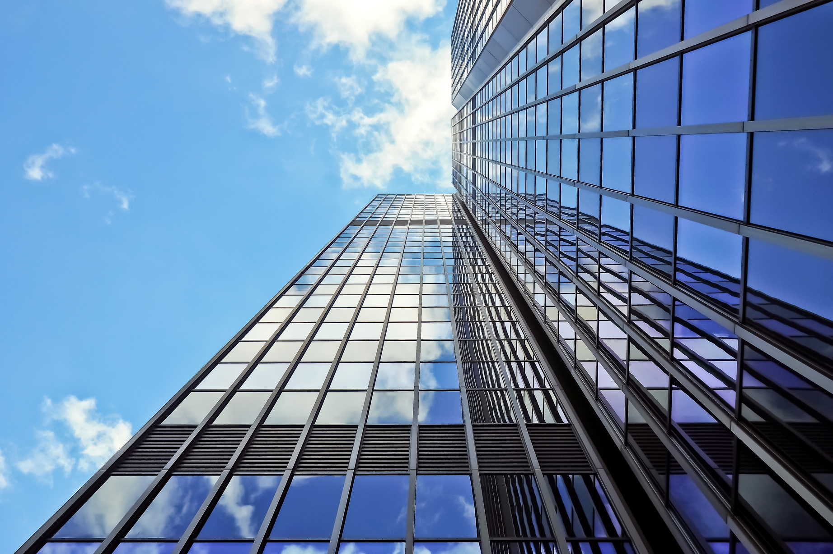

SMART
CITY
MUMBAI

Slide 2

PROBLEM STATEMENT
Everyday a large number of people are coming to cities for seeking jobs, business, tourism, etc. Initially all the places of the city are unknown to the new comers in the city. They don’t know much about booking hotel, transportation, shopping, etc. But implementation of Smart City Project provides the complete solution package for new comers.

Slide 3
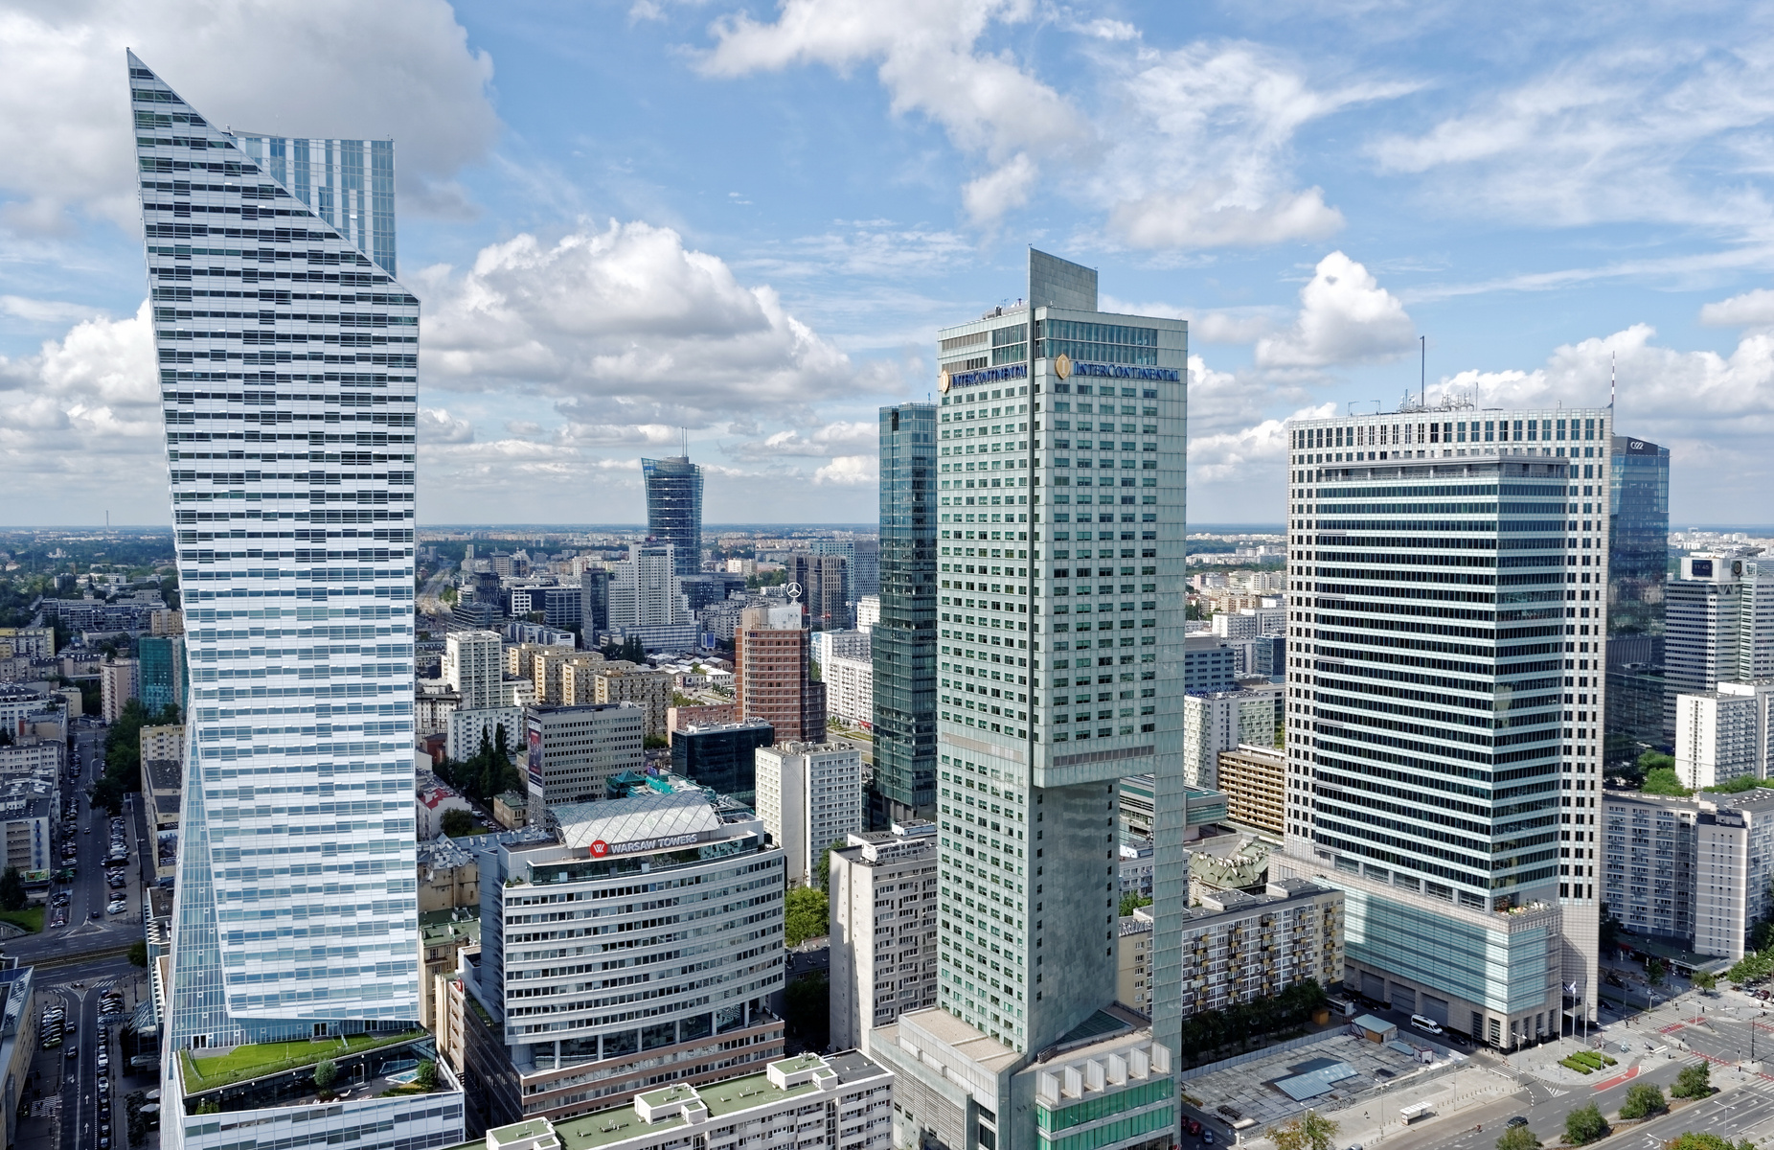
INTRODUCTION
Smart City is a web-based software developed to store the details of a city.
The main purpose of this project to help the tourists and other visitors to the city by providing information about Hotels, Transportation Facilities, Tourist Attractions, Shopping Details, Historical Places, Hidden Gems etc. The Smart City Project serves the visitors as a guide of the city. A "Smart City Mumbai Project" could refer to a software or technology initiative aimed at making Mumbai, a major metropolitan city in India, smarter and more efficient using Programming.

Slide 4
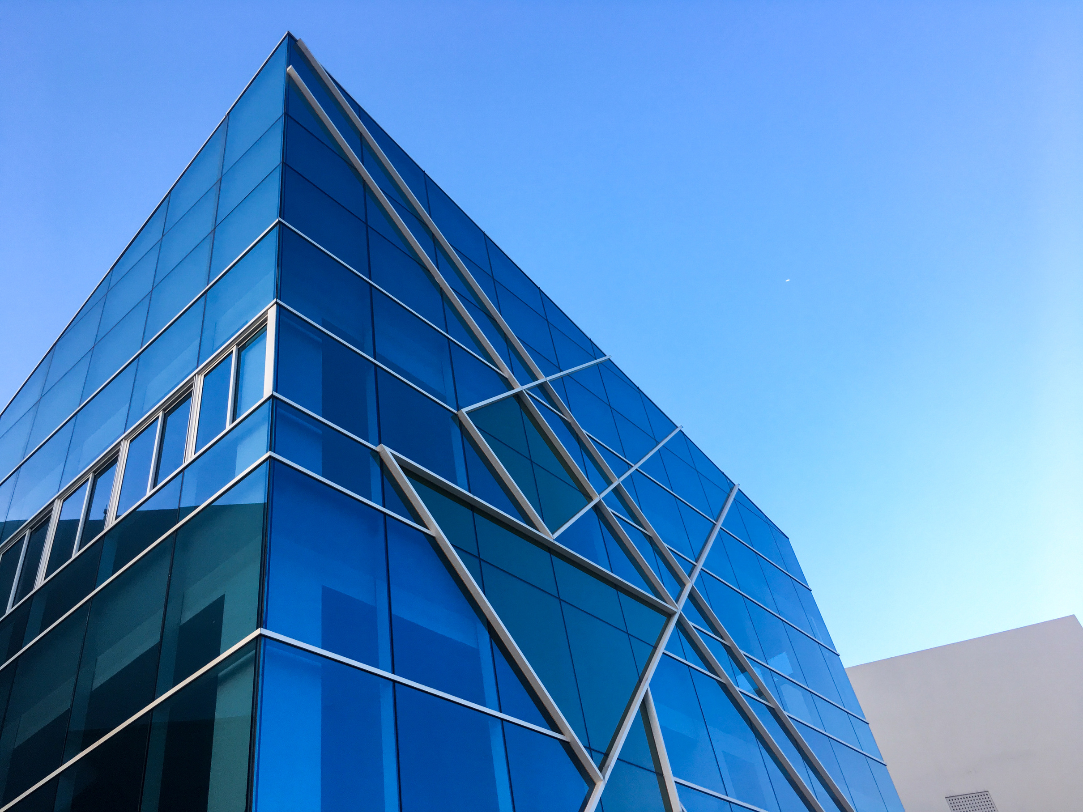
FEATURES
The key features of this Smart City web-based software are:
1• Using this project, the details of city can be accessed from anywhere at any time.
2• The implementation of this city project promotes tourism and business effectively.
3• With the help of this online software, hotels can be searched more easily from anywhere.
4•Tourist can easily know about Historical places and Hidden gems across the city.
5• Information about top Resturants and Flea Markets is provided.
6•Official Links handled by Government of Maharashtra for job seekers is provided.

Slide 5

FLOW CHART
HOME PAGE
LOGIN PAGE
SuccessFul
Main Page
Home Page
About
Services
Pages
Contact
Tabs Page
Resturants
Historical Places
Jobs
Temples
Tourist Attraction
Hotels
Hidden Gems
Flea Markets

Slide 6


FRONTEND
.HTML
.CSS
Languages
used
BACKENDD
BACKEND
Montserrat
.FIREBASE
.JS

Slide 7




THANK YOU
For watching this presentation

